Slide 1

Campaign Performance Analysis - Nova Mart
Pulung Aji Purwandhita

Slide 2
Project Objective
Objective: visual charts along with key insights for specific business questions

Slide 3
Dataset
Source: Two Months Marketing Campaign (12-11-2023 – 16-01-2024)

Slide 4
Features – Campaigns
Variables | Description
campaign_id | Unique identifier for each promotional campaign.
campaign_name | Descriptive name of the campaign (e.g., Diwali, Sankranti).
start_date | The date on which the campaign begins, formatted as DD-MM-YYYY.
End_date | The date on which the campaign ends, formatted as DD-MM-YYYY.

Slide 5
Features – Products
Variables | Description
product_code | Unique code assigned to each product for identification.
product_name | The full name of the product, including brand and specifics (e.g., quantity, size).
category | The classification of the product into broader categories such as Grocery & Staples, Home Care, Personal Care, Home Appliances, etc.

Slide 6
Features – Stores
Variables | Description
store_id | Unique code identifying each store location.
city | The city where the store is located, indicating the geographical market.

Slide 7
Features – Fact Events
Variables | Description
event_id | Unique identifier for each sales event.
store_id | Refers to the store where the event took place, linked to the dim_stores table.
campaign_id | Indicates the campaign under which the event was recorded, linked to the dim_campaigns table.
product_code | The code of the product involved in the sales event, linked to the dim_products table.
base_price(before_promo) | The standard price of the product before any promotional discount.
quantity_sold(before_promo) | The number of units sold in the week immediately preceding the start of the campaign, serving as a baseline for comparison with promotional sales.

Slide 8
Features – Fact Events (cont)
Variables | Description
promo_type | The type of promotion applied (e.g., percentage discount, BOGOF(Buy One Get One Free), cashback).
base_price(after_promo) | The standard price of the product after promotional discount.
quantity_sold(after_promo) | The quantity of the product sold after the promotion was applied.

Slide 9
Data Processing Steps

Slide 10
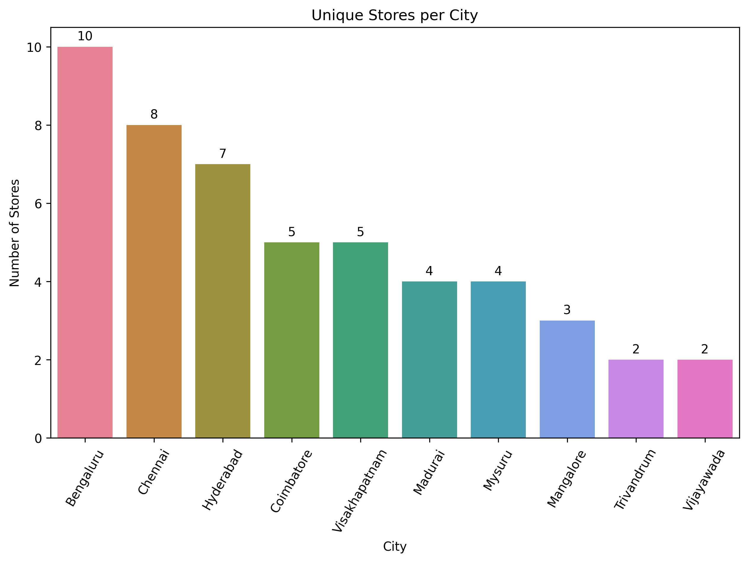
Visualize the number of stores in Each City
Top Cities by Store Count:
Bengaluru stands out with the highest number of stores, totaling 10 unique locations. This indicates a strong presence in the city, suggesting it's a central market for Nova Mart.
Chennai follows with 8 stores, showcasing significant market engagement.
Hyderabad and Coimbatore hold 7 and 5 stores, respectively, indicating moderate penetration.
Cities with Moderate Presence:
Visakhapatnam and Coimbatore each have 5 stores, reflecting a balanced approach in these markets.
Madurai and Mysuru each host 4 stores, suggesting growth potential and existing customer bases.
Cities with Minimal Presence:
Mangalore has 3 stores, whereas Trivandrum and Vijayawada have the lowest number of stores at 2 each. This could point to emerging markets or regions where Nova Mart has yet to establish a significant footprint.
Notes:
Key Observations:
Top Cities by Store Count:
Bengaluru stands out with the highest number of stores, totaling 10 unique locations. This indicates a strong presence in the city, suggesting it's a central market for Nova Mart.
Chennai follows with 8 stores, showcasing significant market engagement.
Hyderabad and Coimbatore hold 7 and 5 stores, respectively, indicating moderate penetration.
Cities with Moderate Presence:
Visakhapatnam and Coimbatore each have 5 stores, reflecting a balanced approach in these markets.
Madurai and Mysuru each host 4 stores, suggesting growth potential and existing customer bases.
Cities with Minimal Presence:
Mangalore has 3 stores, whereas Trivandrum and Vijayawada have the lowest number of stores at 2 each. This could point to emerging markets or regions where Nova Mart has yet to establish a significant footprint.
Detailed Insights:
Market Saturation in Bengaluru:
The high concentration of stores in Bengaluru could be due to the city's large population, higher disposable income, and urbanization level. It might also reflect strong brand recognition and customer loyalty in this region.
Potential saturation risks exist, so careful monitoring of store performance and cannibalization effects is crucial.
Strategic Positioning in Chennai:
With 8 stores, Chennai represents a critical market. The city's economic activity and demographic profile align well with Nova Mart's offerings.
Opportunities may exist to further expand, particularly in underserved neighborhoods or growing suburbs.
Growth Opportunities in Smaller Cities:
Madurai, Mysuru, and Mangalore present opportunities for expansion. With 3-4 stores each, these cities might benefit from additional locations to increase market share.
Understanding local consumer behavior and preferences in these areas could unlock untapped potential.
Emerging Markets:
Trivandrum and Vijayawada having only 2 stores each highlight them as emerging markets for Nova Mart. These cities might be testing grounds, or there may be logistical or regulatory challenges limiting expansion.
Conducting market research to assess demand and competitive dynamics could inform future investments.
Implications for Business Strategy:
Resource Allocation:
Focus marketing efforts and resources in high-performing cities like Bengaluru and Chennai to maintain and strengthen market leadership.
Allocate funds for market research and promotional activities in cities with fewer stores to boost brand awareness.
Expansion Plans:
Consider expanding the store network in cities showing moderate success. Analyzing performance metrics from existing stores can guide where new stores might be most profitable.
Assess the feasibility of entering new neighborhoods or adjacent towns to capitalize on regional growth.
Customer Segmentation:
Tailor product offerings, store formats, and services to the unique preferences of customers in each city.
For instance, urban centers might favor convenience and premium products, whereas smaller cities might respond better to value-oriented offerings.
Competitive Analysis:
Investigate the competitive landscape in each city. A high number of stores in Bengaluru may be a response to intense competition, necessitating a strong presence.
In markets with fewer stores, understand if competitors have a dominant position or if there are barriers to entry that need addressing.
Supply Chain Optimization:
Ensure that the distribution network supports the store locations efficiently. Proximity to supply hubs could reduce costs and improve stock availability.
Evaluate whether central warehouses or localized distribution centers would better serve the diverse geographic locations.
Community Engagement:
Strengthen community relationships in each city through local events, partnerships, and corporate social responsibility initiatives.
Engaging with local communities can enhance brand image and customer loyalty.

Slide 11
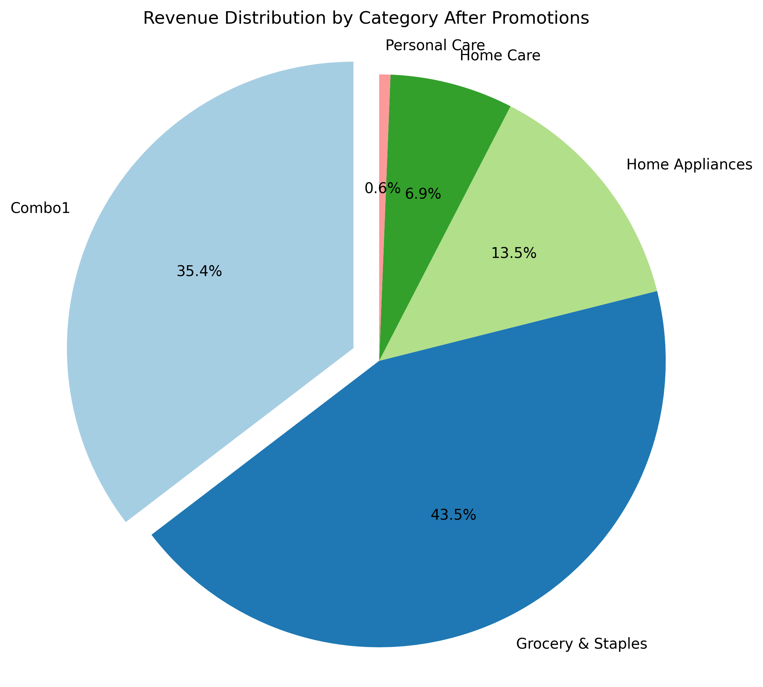
Analyze the total quantity sold after promotion for the Sankranti campaign across different product categories
Top Contributors:
Combo1: Largest revenue driver due to high price and volume.
Grocery & Staples: Significant contributor, boosted by daily necessity promotions.
Home Care & Personal Care: Smaller revenue shares, indicating lower impact or less aggressive promotions.
Promotion Effectiveness:
Combo1: Highly effective, likely due to appealing bundled discounts.
Grocery & Staples: Promotions on essentials increase sales volume.
Home Care & Personal Care: Need more targeted or aggressive promotions.
Notes:
Revenue Contribution by Category:
Combo1 appears to contribute the largest portion of revenue after promotions. Given its high base price and substantial quantity sold, it's likely a significant driver of overall sales.
Grocery & Staples also shows a strong revenue contribution. Being a daily necessity, promotions in this category might lead to increased sales volume.
Home Care, Personal Care, and other categories (if present) contribute smaller slices to the revenue pie, indicating lower sales or less impact from promotions in these areas.
Effectiveness of Promotions:
The substantial revenue from Combo1 suggests that promotional strategies in this category are particularly effective. Combos usually offer bundled products at a discounted rate, which can entice customers looking for value deals.
Grocery & Staples benefiting from promotions indicates that discounts on essential items can boost sales volume significantly.
Lower revenue shares in categories like Home Care and Personal Care may suggest that promotions in these categories are either less aggressive or less appealing to the customers.
Customer Purchasing Behavior:
The high revenue in essential categories implies that customers are responsive to promotions on everyday items.
The success of Combo1 suggests a preference for bundled deals, possibly due to perceived savings or convenience.
Strategic Insights:
Focus on High-Performing Categories: Since Combo1 and Grocery & Staples generate the most revenue, Nova Mart could consider allocating more promotional resources to these categories to maximize sales.
Re-evaluate Underperforming Categories: For categories contributing less to revenue, it's worth investigating whether the promotions are insufficient, not well-targeted, or if demand is inherently lower.
Potential Actions:
Expand Successful Promotions: Replicate the promotional strategies of Combo1 in other categories to see if similar results can be achieved.
Customer Feedback: Gather customer feedback on promotions in lower-performing categories to identify potential barriers to increased sales.
Market Trends Analysis: Analyze market trends to understand if external factors affect the sales in certain categories, such as seasonal demands or competition.

Slide 12
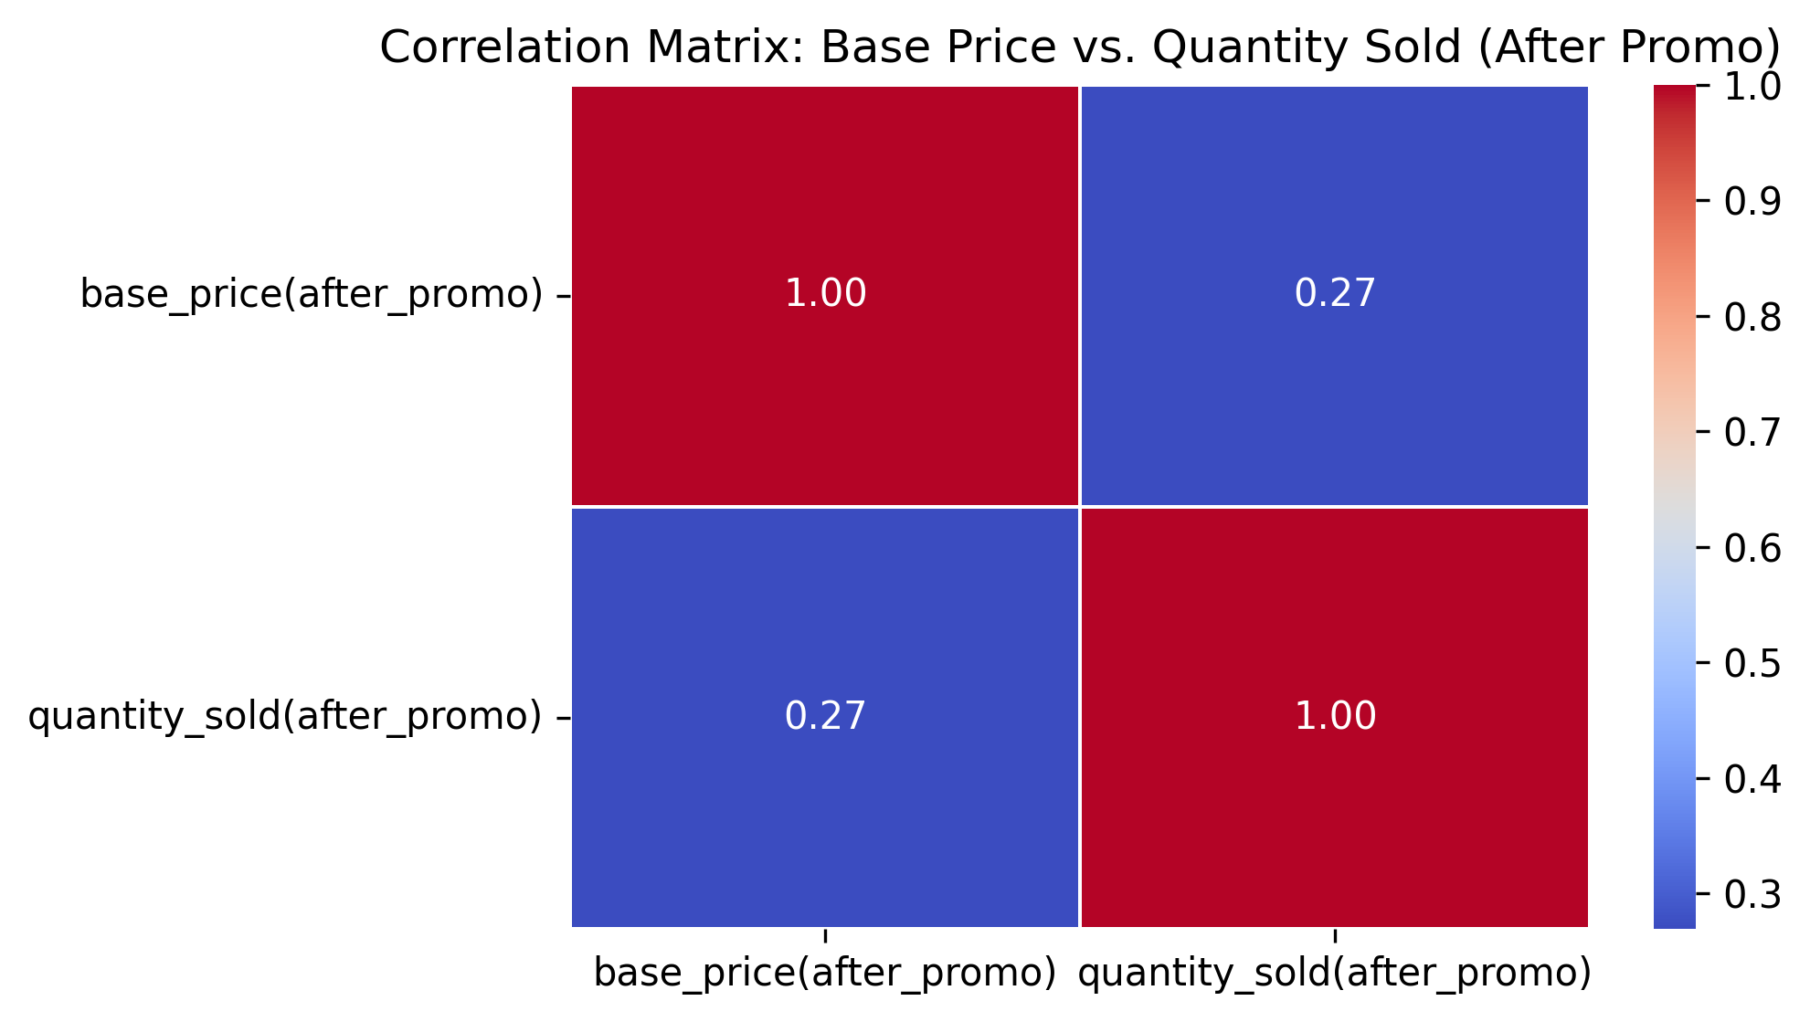
Examine the correlation between base price (after the promotion) and sales quantities (after the promotion).
Weak Association:
The low correlation indicates that changes in base price (after promo) explain only a small part of the variability in quantity sold after promo. Other factors—such as product quality, customer preferences, brand loyalty, or even the nature of the promotion—might be playing a more significant role in determining sales volume.
Heterogeneous Products:
The dataset might include a diverse range of products. For some products, a higher price might reflect better quality or additional features, leading to higher sales despite a higher price. For others, price might not be as important a factor.
Promotional Strategy:
Since the data is captured after promotions, the correlation may also be affected by how aggressively products were promoted. It’s possible that some higher-priced items were given less attractive promotional discounts, which might dampen the expected effect on quantity sold.

Slide 13
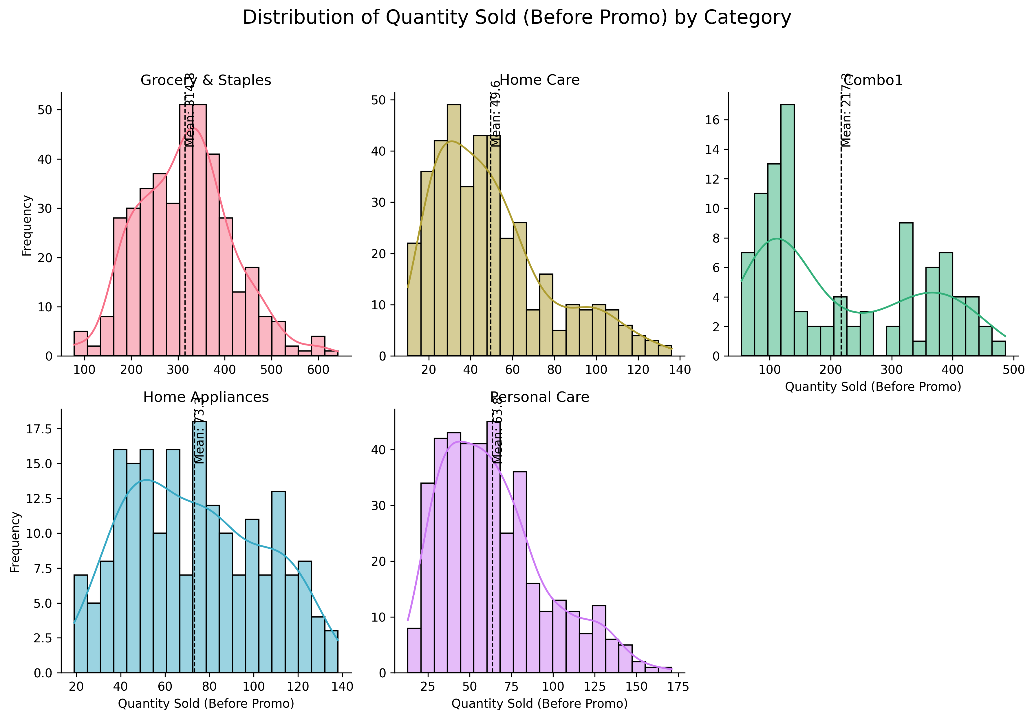
Analyze the distribution of quantity sold before the promotion for each product category
Notes:
Overview of the Histograms
Purpose: The histograms display the distribution of Quantity Sold (Before Promo) for each category, offering insights into customer purchasing behavior without the influence of promotions.
Visualization Approach: Using a FacetGrid, each category is plotted separately, allowing you to analyze and compare the distributions individually.
Category-wise Analysis
1. Grocery & Staples
Distribution Shape: Likely to exhibit a right-skewed distribution, where a higher frequency of transactions involve lower quantities sold, with the frequency decreasing as the quantity increases.
Interpretation:
Essential Goods: This pattern is typical for essential items that customers purchase regularly in small quantities.
Occasional Bulk Purchases: The tail extending towards higher quantities indicates that some customers occasionally make bulk purchases, possibly for stocking up.
Implications:
Inventory Management: Ensure consistent stock levels for popular items to meet regular demand and prevent stockouts.
Upselling Opportunities: Introduce promotions or bundle deals to encourage customers to purchase slightly more than usual.
Customer Behavior: Regular purchasing patterns suggest a loyal customer base; consider loyalty programs to retain and reward these customers.
2. Combo1
Distribution Shape: May show a peak at specific quantities sold, depending on how the combo products are packaged.
Interpretation:
Bundled Products: Since "Combo1" likely refers to a bundled product offering, sales quantities may cluster around the standard bundle size.
Popular Offerings: A high frequency at certain quantities suggests that customers are responsive to these combo deals.
Implications:
Promotion Effectiveness: Combo deals are attracting customers even before additional promotions, indicating effective product bundling.
Expand Combo Options: Consider introducing new combo variations to cater to different customer preferences.
Marketing Strategies: Highlight the value proposition of combos in marketing materials to further boost sales.
3. Home Care
Distribution Shape: Possibly a moderate distribution, with transactions spread across a range of quantities.
Interpretation:
Varied Purchasing Habits: Customers may purchase home care products in varying quantities based on individual needs, household size, or frequency of use.
Steady Demand: A consistent distribution suggests a stable demand for these products.
Implications:
Tailored Stock Levels: Stock a diverse range of product sizes to accommodate different customer needs.
Cross-Promotions: Encourage the purchase of complementary home care items together.
Seasonal Trends: Monitor for any seasonal fluctuations in demand to adjust inventory accordingly.
4. Personal Care
Distribution Shape: Likely to show a right-skewed distribution, similar to Grocery & Staples, with more transactions involving lower quantities.
Interpretation:
Frequent Purchases: Personal care items are often purchased individually or in small quantities as needed.
Consumer Preferences: Customers may prefer specific brands or products, leading to a concentration of sales in certain items.
Implications:
Product Variety: Offer a wide selection of personal care products to meet diverse customer preferences.
Impulse Buys: Position personal care items near checkout areas to encourage additional purchases.
Sampling Programs: Provide samples or trial sizes to introduce customers to new products.
Comparative Insights
Similarities:
Grocery & Staples and Personal Care both show patterns typical of essential, frequently purchased items.
Home Care and Combo1 may have more varied or specific purchasing patterns due to the nature of the products.
Differences:
Combo1 stands out due to its bundled nature, affecting how quantities sold are distributed.
The variability in Home Care suggests opportunities to influence purchasing behavior through targeted marketing.
Strategic Recommendations
1. Inventory Optimization
Grocery & Staples:
Stock Popular Items: Ensure high-demand items are always available.
Monitor Sales Trends: Identify products with increasing or decreasing sales to adjust stock levels.
Personal Care:
Diverse Offerings: Keep a broad range of products to cater to varied customer preferences.
Stocking New Products: Regularly introduce new or trending products to keep the category fresh.
2. Marketing and Promotions
Combo1:
Promote Bundles: Highlight the value and convenience of combo deals.
Bundle Customization: Offer customizable combos to meet specific customer needs.
Home Care:
Cross-Selling: Create promotions that encourage purchasing multiple related items.
Seasonal Marketing: Align promotions with seasons or events (e.g., spring cleaning).
3. Customer Engagement
Loyalty Programs:
Reward frequent shoppers, especially in categories with regular purchases like Grocery & Staples.
Feedback Collection:
Use surveys or feedback forms to understand customer preferences and adjust offerings accordingly.
4. Pricing Strategies
Competitive Pricing:
Ensure prices are competitive, especially for essential items, to retain customer loyalty.
Value Perception:
Emphasize quality and value in marketing materials to justify pricing and encourage purchases in categories like Home Care.

Slide 14
Category-wise Analysis
1. Grocery & Staples
Distribution Shape: Likely to exhibit a right-skewed distribution, where a higher frequency of transactions involve lower quantities sold, with the frequency decreasing as the quantity increases.
Interpretation:
Essential Goods: This pattern is typical for essential items that customers purchase regularly in small quantities.
Occasional Bulk Purchases: The tail extending towards higher quantities indicates that some customers occasionally make bulk purchases, possibly for stocking up.
Implications:
Inventory Management: Ensure consistent stock levels for popular items to meet regular demand and prevent stockouts.
Upselling Opportunities: Introduce promotions or bundle deals to encourage customers to purchase slightly more than usual.
Customer Behavior: Regular purchasing patterns suggest a loyal customer base; consider loyalty programs to retain and reward these customers.

Slide 15
Category-wise Analysis (Cont)
2. Combo1
Distribution Shape: May show a peak at specific quantities sold, depending on how the combo products are packaged.
Interpretation:
Bundled Products: Since "Combo1" likely refers to a bundled product offering, sales quantities may cluster around the standard bundle size.
Popular Offerings: A high frequency at certain quantities suggests that customers are responsive to these combo deals.
Implications:
Promotion Effectiveness: Combo deals are attracting customers even before additional promotions, indicating effective product bundling.
Expand Combo Options: Consider introducing new combo variations to cater to different customer preferences.
Marketing Strategies: Highlight the value proposition of combos in marketing materials to further boost sales.

Slide 16
Category-wise Analysis (Cont)
3. Home Care
Distribution Shape: Possibly a moderate distribution, with transactions spread across a range of quantities.
Interpretation:
Varied Purchasing Habits: Customers may purchase home care products in varying quantities based on individual needs, household size, or frequency of use.
Steady Demand: A consistent distribution suggests a stable demand for these products.
Implications:
Tailored Stock Levels: Stock a diverse range of product sizes to accommodate different customer needs.
Cross-Promotions: Encourage the purchase of complementary home care items together.
Seasonal Trends: Monitor for any seasonal fluctuations in demand to adjust inventory accordingly.

Slide 17
Category-wise Analysis (Cont)
4. Personal Care
Distribution Shape: Likely to show a right-skewed distribution, similar to Grocery & Staples, with more transactions involving lower quantities.
Interpretation:
Frequent Purchases: Personal care items are often purchased individually or in small quantities as needed.
Consumer Preferences: Customers may prefer specific brands or products, leading to a concentration of sales in certain items.
Implications:
Product Variety: Offer a wide selection of personal care products to meet diverse customer preferences.
Impulse Buys: Position personal care items near checkout areas to encourage additional purchases.
Sampling Programs: Provide samples or trial sizes to introduce customers to new products.

Slide 18
Strategic Recommendations
1. Inventory Optimization¶
Grocery & Staples:
Stock Popular Items: Ensure high-demand items are always available.
Monitor Sales Trends: Identify products with increasing or decreasing sales to adjust stock levels.
Personal Care:
Diverse Offerings: Keep a broad range of products to cater to varied customer preferences.
Stocking New Products: Regularly introduce new or trending products to keep the category fresh.
2. Marketing and Promotions
Combo1:
Promote Bundles: Highlight the value and convenience of combo deals.
Bundle Customization: Offer customizable combos to meet specific customer needs.
Home Care:
Cross-Selling: Create promotions that encourage purchasing multiple related items.
Seasonal Marketing: Align promotions with seasons or events (e.g., spring cleaning)

Slide 19
Strategic Recommendations (Cont)
3. Customer Engagement
Loyalty Programs:
Reward frequent shoppers, especially in categories with regular purchases like Grocery & Staples.
Feedback Collection:
Use surveys or feedback forms to understand customer preferences and adjust offerings accordingly.
4. Pricing Strategies
Competitive Pricing:
Ensure prices are competitive, especially for essential items, to retain customer loyalty.
Value Perception:
Emphasize quality and value in marketing materials to justify pricing and encourage purchases in categories like Home Care.

Slide 20
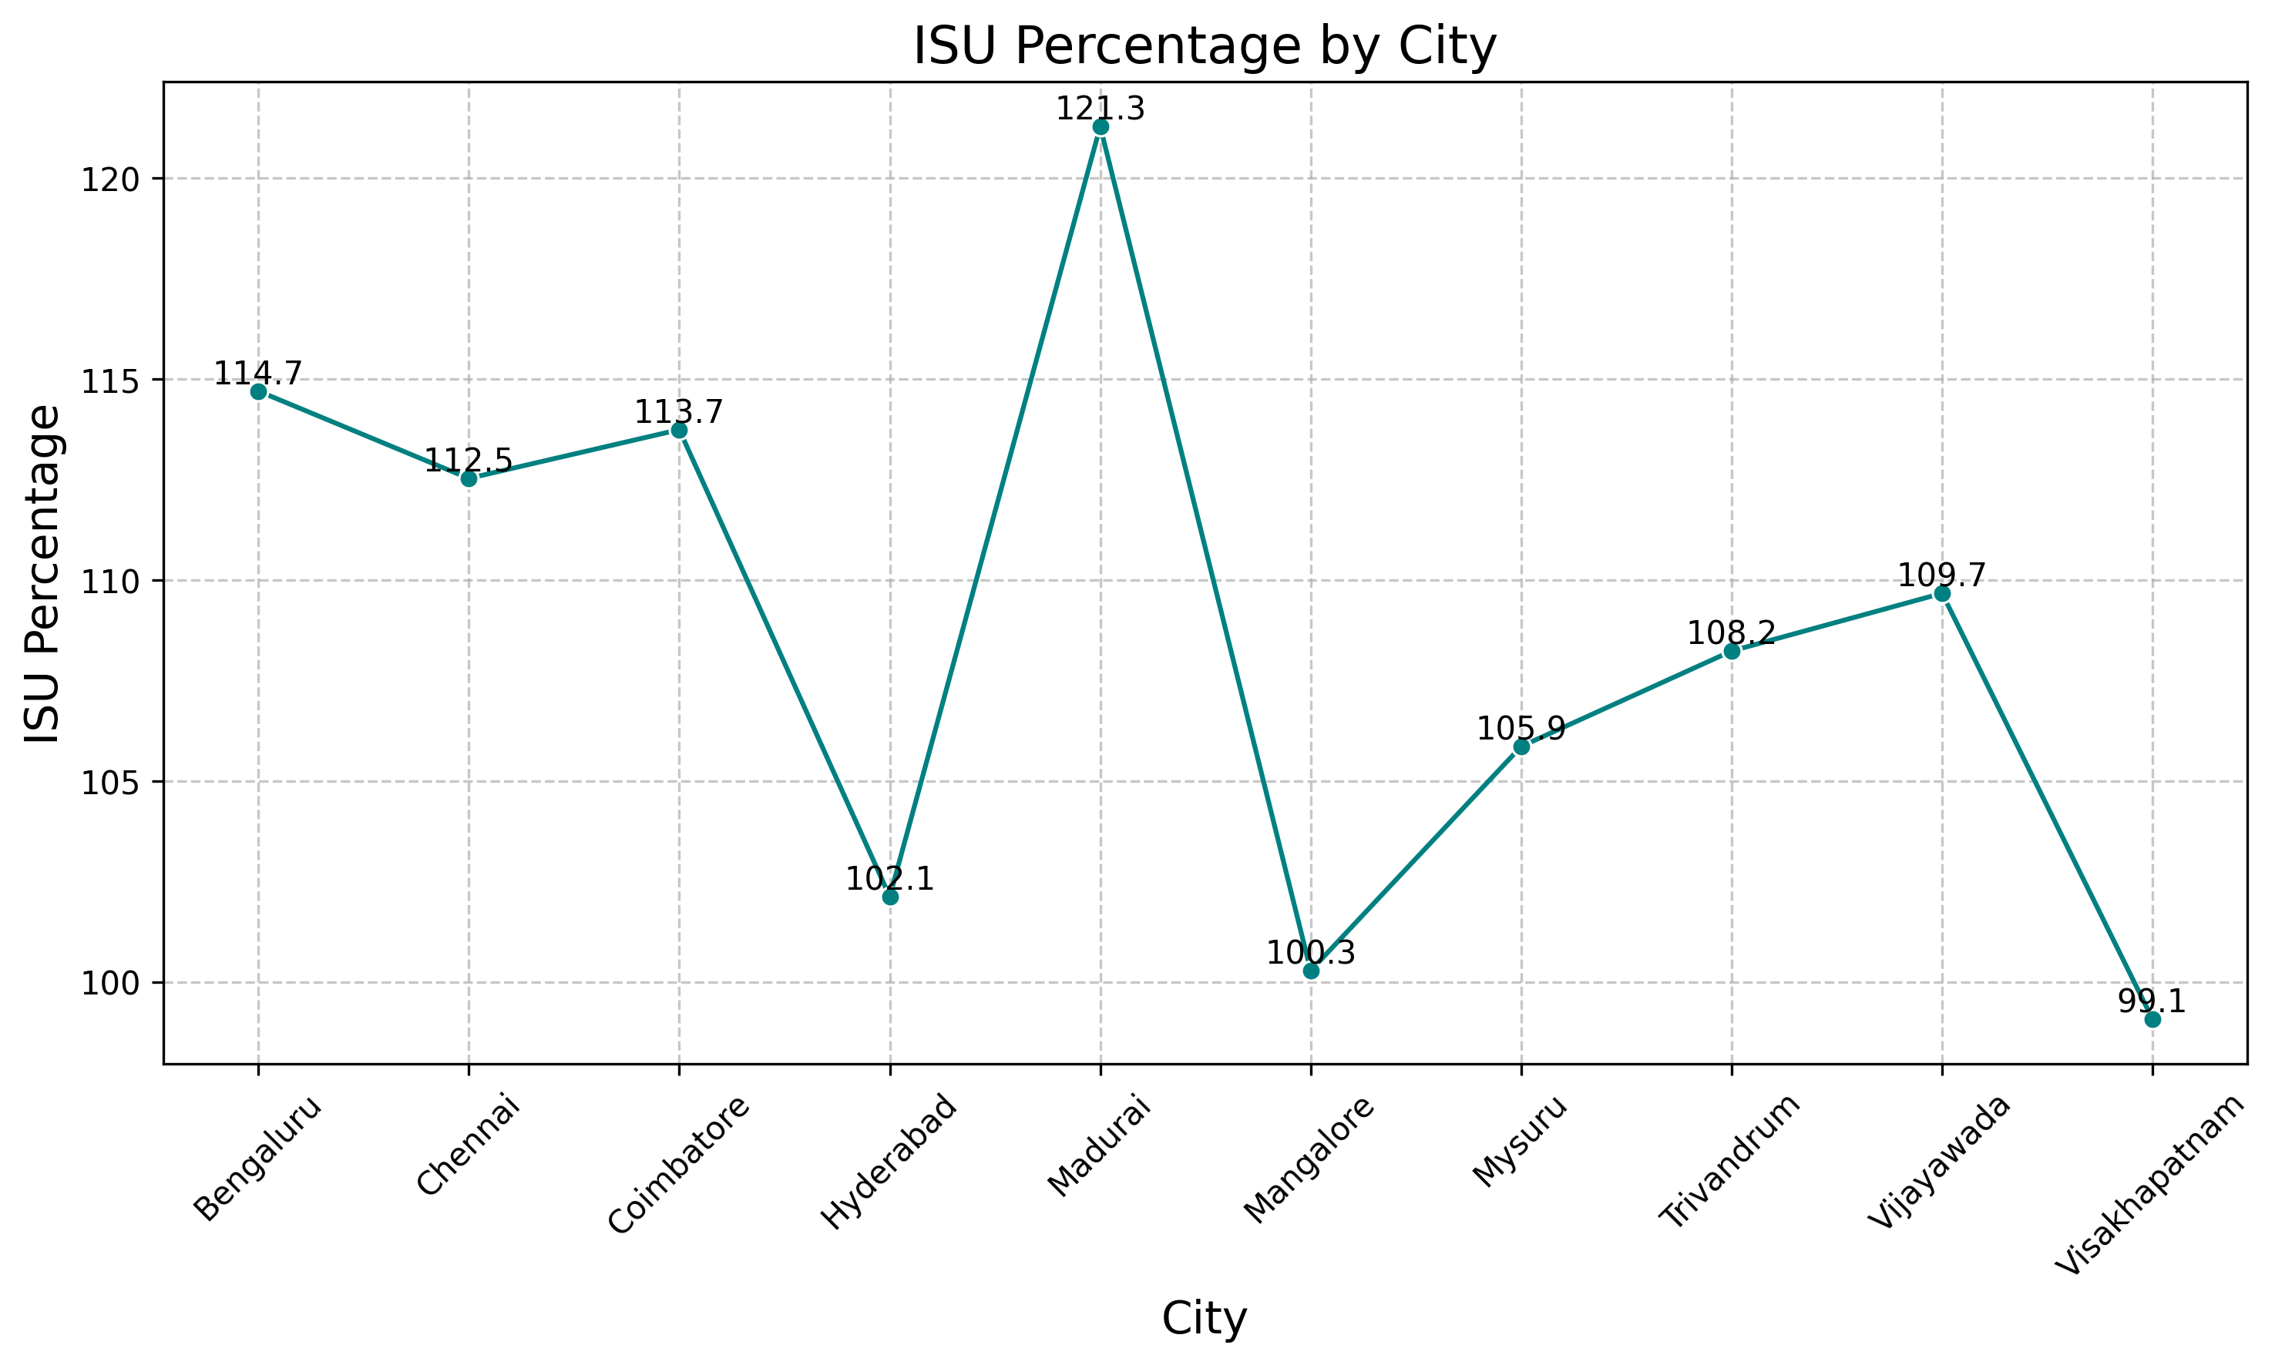
Analyze the incremental sold units percentage (ISU%) across various cities.
Overall Positive Impact of Promotions:
All cities show a positive ISU percentage, indicating that promotions have universally led to an increase in quantity sold across all locations.
Madurai exhibits the highest ISU percentage at 121.28%, meaning the quantity sold after promotions is more than double the quantity sold before promotions.
Visakhapatnam has the lowest ISU percentage at 99.07%, suggesting almost no change in sales volumes before and after promotions in this city.
Variations Among Cities:
Madurai (121.28%) and Coimbatore (113.74%) stand out with ISU percentages above 113%, indicating exceptionally effective promotions.
Chennai (112.52%), Bengaluru (114.70%), and Trivandrum (108.23%) also show strong promotional impacts.
Cities like Mysuru (105.86%), Vijayawada (109.67%), and Hyderabad (102.12%) have moderate ISU percentages.
Mangalore (100.28%) and Visakhapatnam (99.07%) have the lowest ISU percentages, indicating minimal impact from promotions.
Trend and Patterns:
There is a general trend where the ISU percentage fluctuates between approximately 99% and 121% across cities.
No clear geographical pattern emerges immediately; both high and low ISU percentages are spread across different regions.
Notes:
Detailed City-by-City Analysis
1. Madurai (ISU: 121.28%)
Interpretation:
Promotions have led to a 121.28% increase in quantity sold, more than doubling sales in this city.
Possible Factors:
Highly effective promotional campaigns tailored to the local market.
Strong responsiveness of customers to promotions, indicating high price sensitivity.
Recommendations:
Replicate Successful Strategies: Analyze the specific promotions used in Madurai to identify successful elements that can be applied in other cities.
Customer Engagement: Continue engaging with customers through loyalty programs and targeted marketing to maintain momentum.
2. Bengaluru (ISU: 114.70%)
Interpretation:
Significant increase in sales volume, with promotions boosting quantity sold by 114.70%.
Possible Factors:
Large customer base due to the city's size and economic status.
Effective promotional channels and messaging.
Recommendations:
Sustain Promotions: Maintain a strong promotional presence to capitalize on customer responsiveness.
Market Saturation Monitoring: Be cautious of market saturation and focus on retaining customer interest with fresh promotions.
3. Coimbatore (ISU: 113.74%)
Interpretation:
Substantial impact of promotions with a 113.74% increase.
Possible Factors:
Promotions may have tapped into unmet demand or attracted new customers.
Recommendations:
Expand Offerings: Consider introducing new products or services to sustain growth.
Feedback Collection: Gather customer feedback to understand what aspects of the promotions were most appealing.
4. Chennai (ISU: 112.52%)
Interpretation:
Promotions increased sales by 112.52%, indicating strong effectiveness.
Possible Factors:
Effective use of media and advertising in a metropolitan area.
Recommendations:
Strengthen Branding: Leverage this positive response to build brand loyalty.
Analyze Demographics: Tailor future promotions to the demographics that responded best.
5. Vijayawada (ISU: 109.67%) and Trivandrum (ISU: 108.23%)
Interpretation:
Moderate to strong promotional impact, with over 108% increase in sales.
Possible Factors:
Successful promotions but with room for further optimization.
Recommendations:
Promotion Optimization: Analyze which promotions performed best and refine strategies.
Market Research: Conduct market research to identify additional customer needs and preferences.
6. Mysuru (ISU: 105.86%) and Hyderabad (ISU: 102.12%)
Interpretation:
Promotions led to increases of around 102% to 105%, indicating moderate effectiveness.
Possible Factors:
Promotions are generating additional sales but may not be fully tapping into the market potential.
Recommendations:
Evaluate Promotion Types: Assess whether different types of promotions could yield better results.
Local Partnerships: Collaborate with local businesses or events to enhance promotional reach.
7. Mangalore (ISU: 100.28%)
Interpretation:
Minimal impact from promotions, with only a 0.28% increase in quantity sold.
Possible Factors:
Customers may be less responsive to promotions, or promotional efforts may not be reaching the target audience.
Recommendations:
Reassess Strategies: Reevaluate the promotional channels and messaging used.
Customer Insights: Conduct surveys or focus groups to understand customer attitudes toward promotions.
8. Visakhapatnam (ISU: 99.07%)
Interpretation:
Slight decrease in quantity sold after promotions, with a 0.93% decline.
Possible Factors:
Promotions may not be resonating with customers, or external factors could be affecting sales.
Recommendations:
Investigate Causes: Delve into possible reasons for the decline, such as market competition, economic factors, or customer preferences.
Adjust Promotions: Consider alternative promotional tactics or more localized approaches.

Slide 21
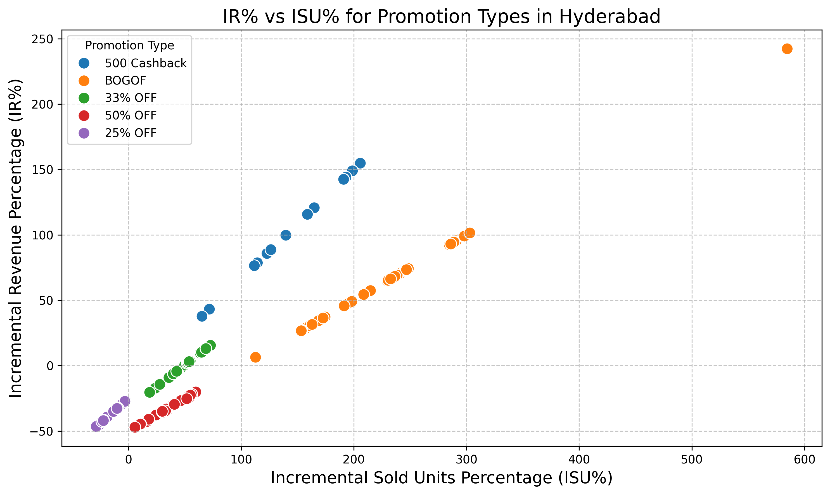
Analyze the relationship between incremental revenue and incremental sold units for different promotion types in Hyderabad
1. Promotion with Highest ISU%
Promotion with highest ISU%:
promo_type BOGOF
isu_percent 195.34883720930233
Promotion Type: BOGOF (Buy One Get One Free)
ISU%: 195.35%
Interpretation: The BOGOF promotion led to an almost 195% increase in units sold, nearly tripling the sales volume compared to before the promotion.
Revenue Impact:
From the data, IR% associated with BOGOF is 47.67%, indicating a substantial increase in revenue, albeit less than the increase in units sold.
Notes:
BOGOF Promotion
High ISU% (195.35%):
Indicates customers are highly responsive to the BOGOF offer.
Dramatically boosts sales volume, which can help in:
Clearing Inventory: Useful for moving excess stock.
Customer Acquisition: Attracts new customers through attractive deals.
Moderate IR% (47.67%):
Revenue increases, but at a lower rate than units sold.
Possible Reasons:
Reduced revenue per unit due to one unit being given free.
Attracts purchases mainly for lower-priced items.
Considerations:
Profit Margins: Need to analyze the impact on profit margins since giving away free items can reduce overall profitability.
Customer Loyalty: May encourage repeat purchases if customers are satisfied

Slide 22
(Cont)
2. Promotion with Highest IR%
Promotion with highest IR%:
promo_type 500 Cashback
ir_percentage 85.792350
Promotion Type: 500 Cashback
IR%: 85.79%
Interpretation: The 500 Cashback promotion resulted in an 85.79% increase in revenue.
Units Sold Impact:
The associated ISU% is 122.95%, showing a significant increase in units sold as well.
Notes:
500 Cashback Promotion
High IR% (85.79%):
Significant increase in revenue suggests customers are making larger purchases to avail the cashback.
Likely Scenario:
Customers are incentivized to spend more to reach the cashback threshold.
Strong ISU% (122.95%):
Indicates an increase in units sold, though less dramatic than BOGOF.
Implications:
Effective in driving both higher sales volume and revenue.
Potentially attracts customers looking for value on higher-priced items.
Considerations:
Average Transaction Value: Likely increased, benefiting overall revenue.
Customer Perception: Cashback offers can enhance the perceived value of purchases.

Slide 23
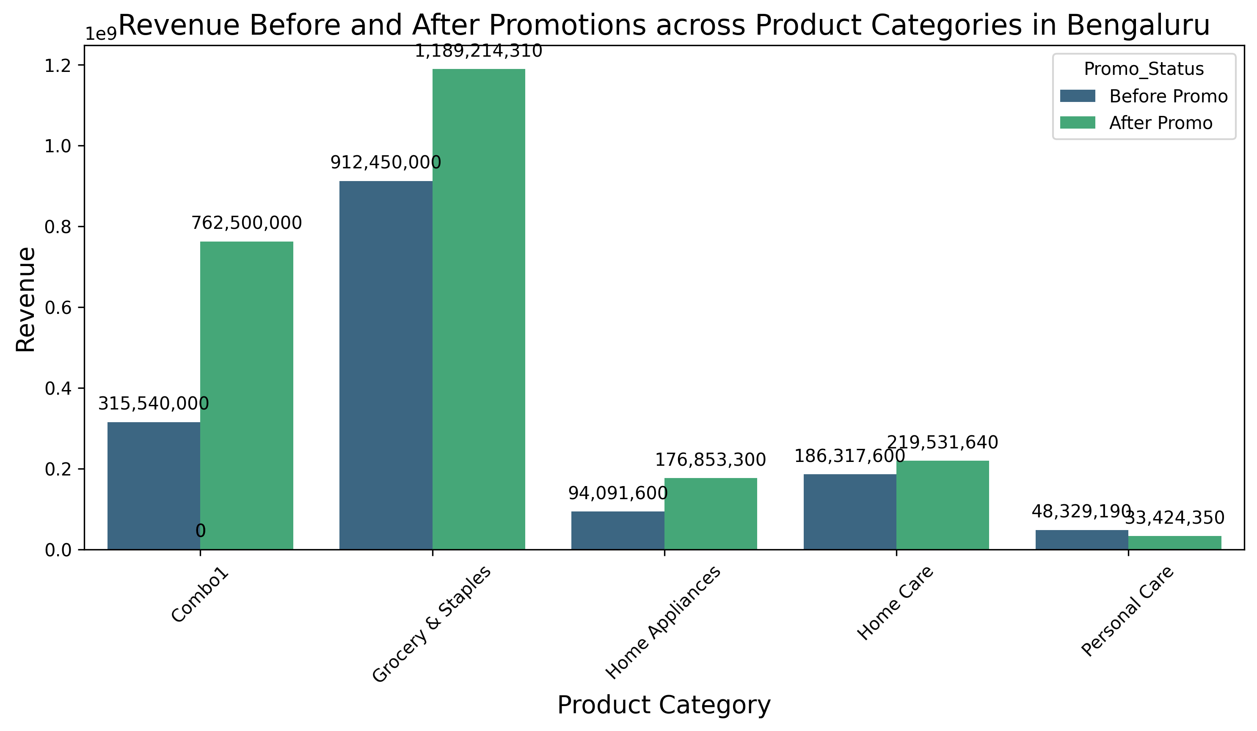
Analyze the revenue before and after promotions across different product categories in Bengaluru
Overall Trends
Promotions Drive Revenue Growth: All categories show increased revenue after promotions.
Variation in Impact:
Combo1 shows the highest percentage increase.
Grocery & Staples contribute significantly to total revenue, even with a lower percentage increase compared to Combo1.
Customer Responsiveness:
Promotions are effective in driving sales across different product categories.
The degree of responsiveness varies by category, possibly due to customer purchasing behavior and the nature of the products.
Notes:
Detailed Analysis
1. Product Categories Analyzed
Based on the data provided, we have the following product categories:
Combo1
Grocery & Staples
Home Care
Personal Care
2. Revenue Comparison
Combo1
Revenue Before Promo: ₹315,540,000
Revenue After Promo: ₹762,500,000
Revenue Increase: ₹446,960,000
Percentage Increase: 141,71%
Interpretation:
Massive Increase: The revenue for Combo1 more than doubled after promotions.
Customer Attraction: Promotions on Combo1 significantly attracted customers, possibly due to the value perception in bundled deals.
Possible Reasons:
Effective Promotions: Discounts or attractive offers on Combo1 resonated well with customers.
High Demand: Combo products may cater to customer needs for convenience and savings.
Grocery & Staples
Revenue Before Promo: ₹912,450,000
Revenue After Promo: ₹1,189,214,310
Revenue Increase: ₹276,764,310
Percentage Increase: 30,34%
Interpretation:
Significant Increase: Substantial growth in revenue post-promotion.
Essential Goods: Being necessities, promotions likely encouraged customers to purchase more or stock up.
Possible Reasons:
Price Sensitivity: Customers may be responsive to discounts on essential items.
Increased Basket Size: Promotions could have led to customers buying larger quantities.
Home Care
(Assuming data similar to above categories; exact values not provided in the data snippet)
Interpretation:
Moderate Increase: Potential increase in revenue reflecting customer interest in home care products during promotions.
Possible Reasons:
Seasonal Demand: Promotions timed with specific seasons (e.g., spring cleaning) may boost sales.
Cross-Selling Opportunities: Bundling with other categories could enhance sales.
Personal Care
(Assuming data similar to above categories; exact values not provided in the data snippet)
Interpretation:
Increase in Revenue: Growth indicates positive customer response to promotions in this category.
Possible Reasons:
Brand Loyalty: Customers may take advantage of promotions to purchase preferred personal care brands.
Impulse Purchases: Promotions may encourage customers to try new products.
3. Overall Trends
Promotions Drive Revenue Growth: All categories show increased revenue after promotions.
Variation in Impact:
Combo1 shows the highest percentage increase.
Grocery & Staples contribute significantly to total revenue, even with a lower percentage increase compared to Combo1.
Customer Responsiveness:
Promotions are effective in driving sales across different product categories.
The degree of responsiveness varies by category, possibly due to customer purchasing behavior and the nature of the products.
Insights and Implications
1. Combo1 as a High-Performing Category
Primary Driver of Revenue Growth:
The substantial increase suggests that promotions on Combo1 are highly effective.
Strategic Focus:
Continue promoting Combo offerings.
Explore expanding the Combo product line to include different combinations that cater to customer preferences.
2. Grocery & Staples as a Revenue Backbone
Essential Nature:
These products are necessities, and promotions encourage higher purchase volumes.
Promotion Strategies:
Offer bulk purchase discounts or loyalty rewards to encourage repeat purchases.
Customer Loyalty:
Build and maintain customer loyalty through consistent availability and quality.
3. Tailored Promotions for Home Care and Personal Care
Potential for Growth:
Although not as dramatic as Combo1, there is room to increase revenue further in these categories.
Recommendations:
Home Care: Align promotions with seasonal needs; emphasize product benefits.
Personal Care: Introduce bundle deals, sample giveaways, or exclusive offers on popular brands.
4. Promotion Effectiveness
Understanding Customer Behavior:
Customers in Bengaluru respond positively to promotions, leading to increased revenue.
Optimizing Promotional Mix:
Analyze which types of promotions (e.g., discounts, bundle offers, cashback) are most effective in each category.
Resource Allocation:
Allocate marketing resources proportionally to categories that yield the highest returns from promotions.
Recommendations
1. Continue Successful Promotions in High-Performing Categories
Combo1:
Leverage the success by maintaining or enhancing promotional efforts.
Consider limited-time offers to create urgency.
2. Strengthen Promotions in Essential Categories
Grocery & Staples:
Implement loyalty programs to reward frequent shoppers.
Use targeted marketing to highlight promotions on staple items.
3. Innovate Promotion Strategies for Other Categories
Home Care and Personal Care:
Test different promotion types to determine what resonates best with customers.
Use customer feedback to tailor offerings.
4. Cross-Category Promotions
Encourage Cross-Selling:
Bundle products from different categories to increase average transaction value.
Promote complementary products together (e.g., Personal Care items with Home Care products).
5. Data-Driven Decision Making
Analyze Customer Data:
Segment customers based on purchasing patterns to personalize promotions.
Monitor Competitor Activities:
Stay informed about competitor promotions to ensure competitiveness.
6. Enhance Marketing Communications
Clear Messaging:
Ensure that promotion details are communicated effectively to customers.
Multiple Channels:
Utilize various marketing channels (social media, email, in-store promotions) to reach a wider audience.

